Slide 1
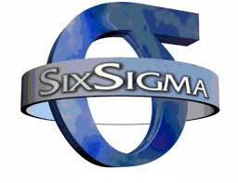
Six Sigma
Zack Howard

Slide 2


Six Sigma technique and tools was developed by Motorola in 1986.
Made famous for use in 1995 by Jack Welch when he made it central to his successful business strategy at General Electric

Slide 3
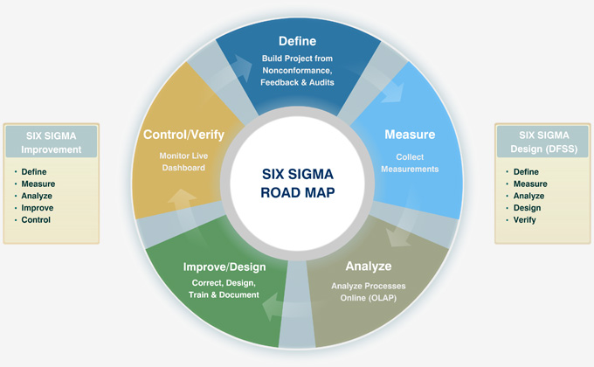
Six Sigma is a business strategy that helps improve business performance.
Gives the business the ability to deliver accelerated business results.
Allows anyone to systematically enhance your processes

Slide 4
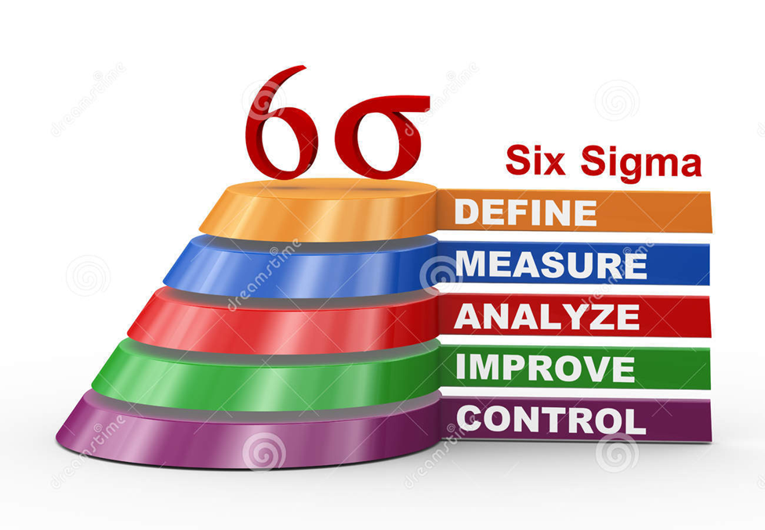
Although the system was never recognized as successful until 1995, when its use increased 700% in 2 years, it was started in 1986.

Slide 5
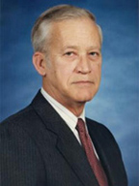
The system originated from the Motorola co in 1986 by employee Bill Smith.

Slide 6

Why is Six Sigma important?
Six Sigma was created as a tool to further enhance business productivity and efficiency

Slide 7
References
http://www.motorolasolutions.com/US-EN/Training+Home/Lean+Six+Sigma
http://www.ge.com/en/company/companyinfo/quality/whatis.htm
http://www.isixsigma.com/new-to-six-sigma/getting-started/what-six-sigma/

